Slide 1
Ansible
Introduction

Slide 2
Plan:
Définition de Ansible.
Install Ansible.
Ansible inventory
What is Yaml?
Ansible playbook
Ansible Modules (commands file)
Ansible Condition
Ansible loop

Slide 3
What is Ansible?
Ansible is an open-source software provisioning, configuration management, and application deployment tool. It runs on many Unix-like systems, and can configure both Unix-like systems as well as Microsoft Windows. It includes its own declarative language to describe system configuration- wikipedia.

Slide 4
Why Ansible?
Brings huge time saving.
Agentless.
Playbooks are easy to read and edit.
It is written in Python.
It is open source.

Slide 5
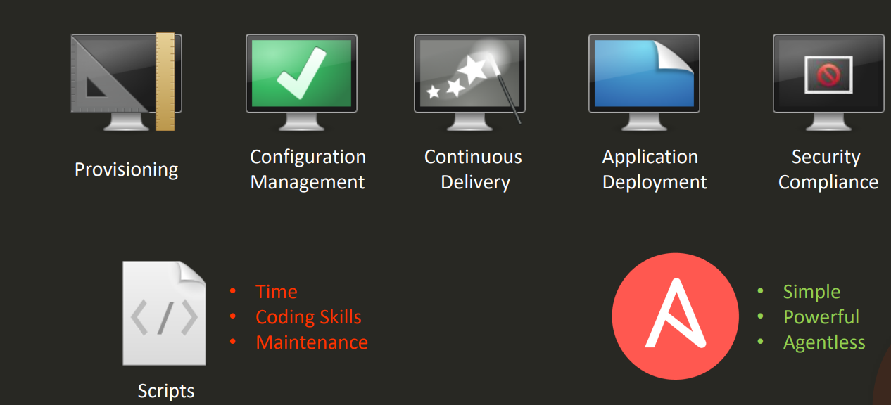
Why Ansible?

Slide 6
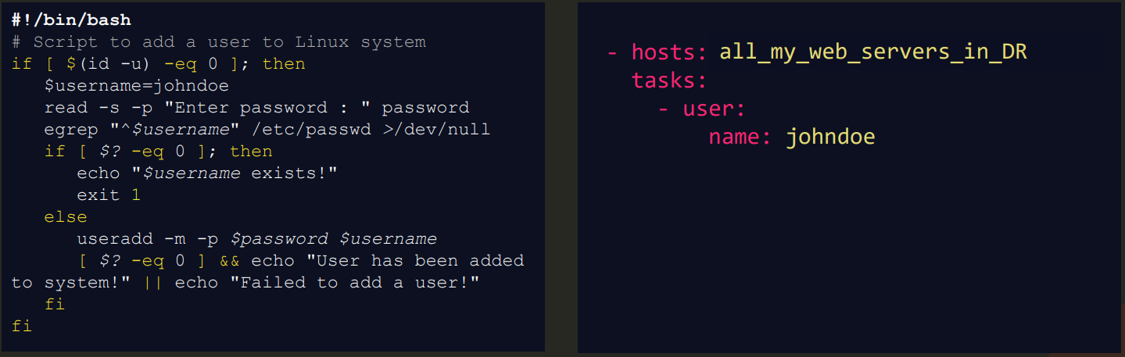
Script vs Ansible playbook

Slide 7
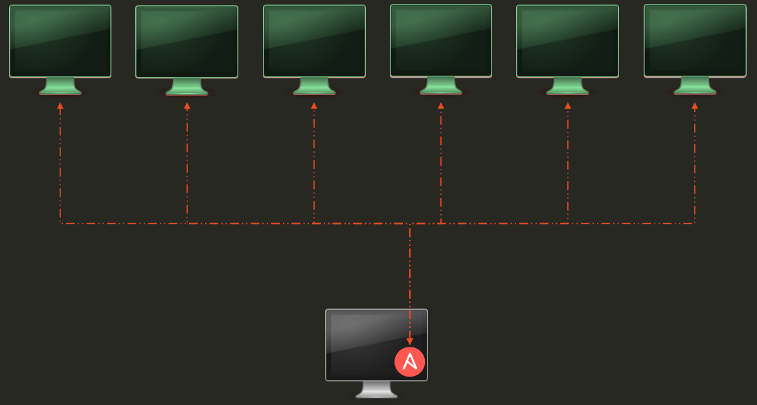
Use case example - simple

Slide 8
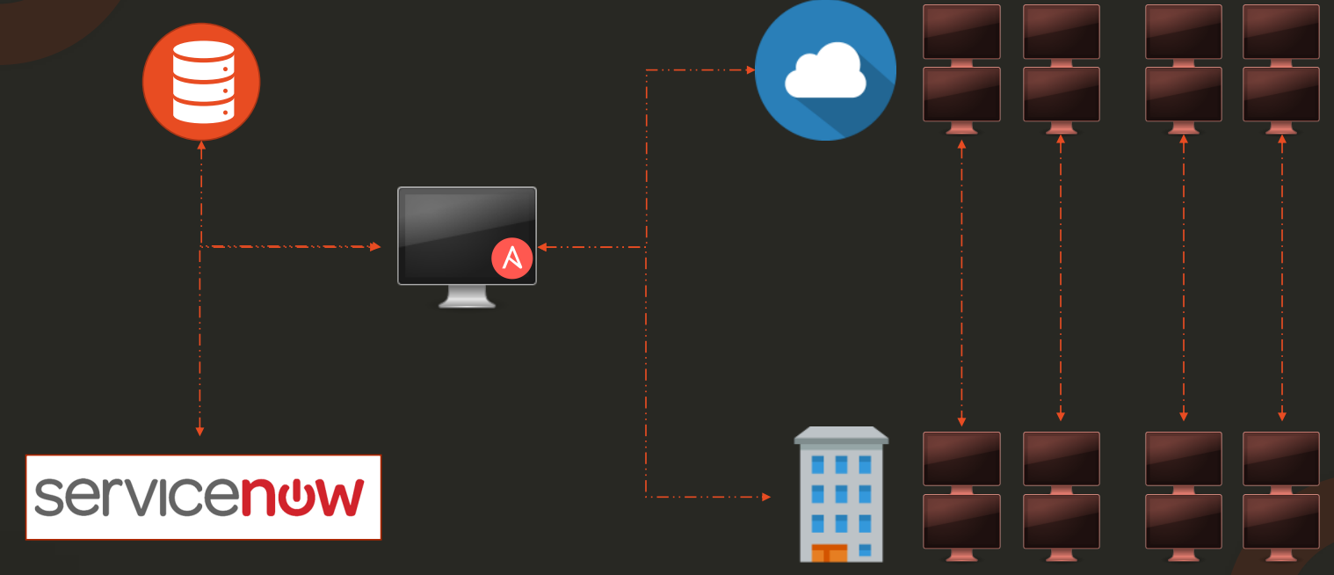
Use case example - complex

Slide 9
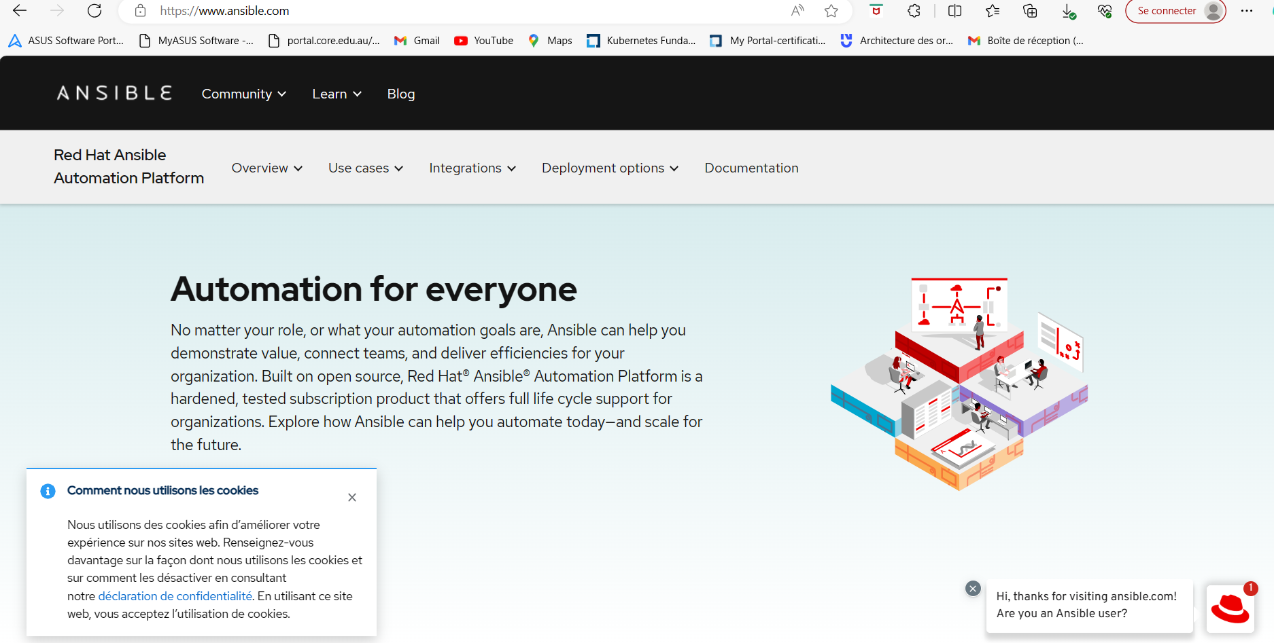
Ansible documentation

Slide 10
Install Ansible
Install Guide (www.ansible.com).
On Centos: $ sudo dnf install ansible ($yum install ansible)
On Debian :$ sudo apt install ansible
$ ansible - - help
$ansible - - version
ansible 2.9.3
config file = /etc/ansible/ansible.cfg
python version =2.7.5
# ansible localhost -m shell -a ‘date’

Slide 11
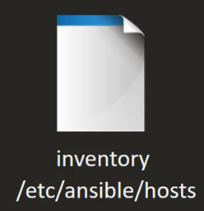
Ansible inventory
Ansible
server
server
server
linux: ssh
Windows: Powershell Remoting
Agentless

Slide 12
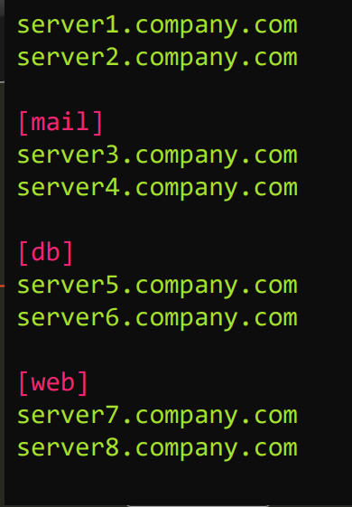
ansible inventory

Slide 13
Ansible inventory
Default location: /etc/ansible/hosts
[webserver]
myserver1.test.com
myserver2.test.com
[api]
myserver3.test.com
myserver4.test.com

Slide 14
Ansible inventory: Parameter
web ansible_host=myserver1.test.com
api ansible_host=myserver2.test.com
cache ansible_host=myserver3.test.com
db ansible_host=myserver4.test.com
localhost ansible_connection=local
Parameter:
ansible_connection: ssh/winrm/local
ansible_port: 22/5986
ansible_user: root/admin
ansible_ssh_pass: Password
Exemple: vim inventory.txt et $ ansible target1 -m ping - - ask-pass -i inventory.txt

Slide 15
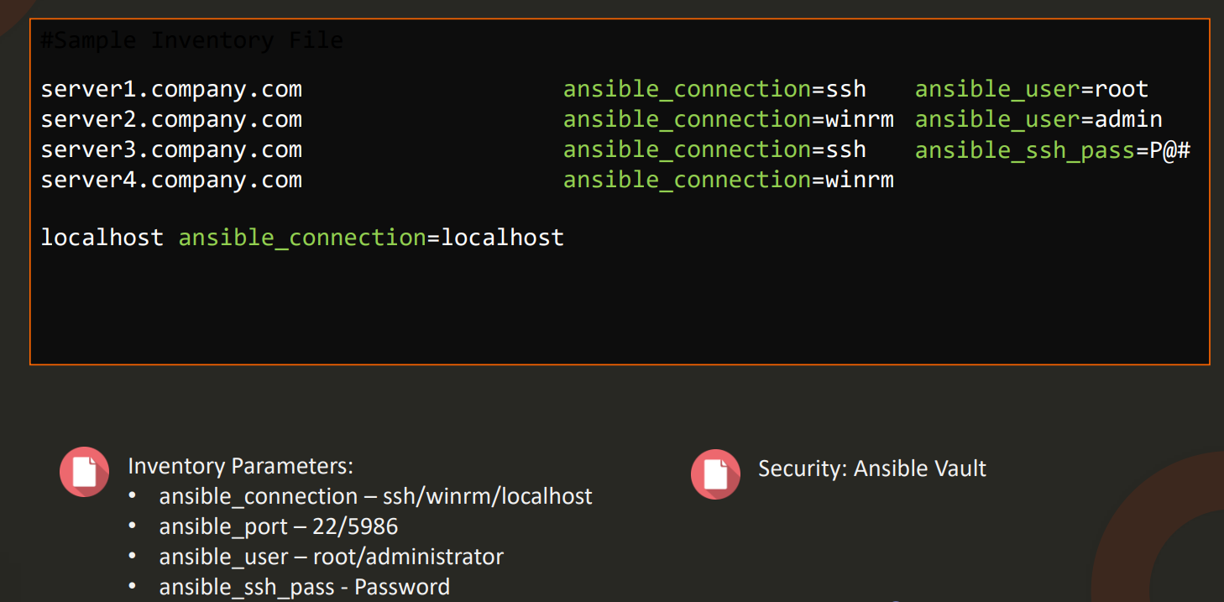
Ansible inventory

Slide 16
What is Yaml?
YAML is a human-readable data serialization standard that can be used in conjunction with all programming languages and is often used to write configuration files.
Extension:
- .yaml
- .yml
exemple: yaml-exemple.yml

Slide 17
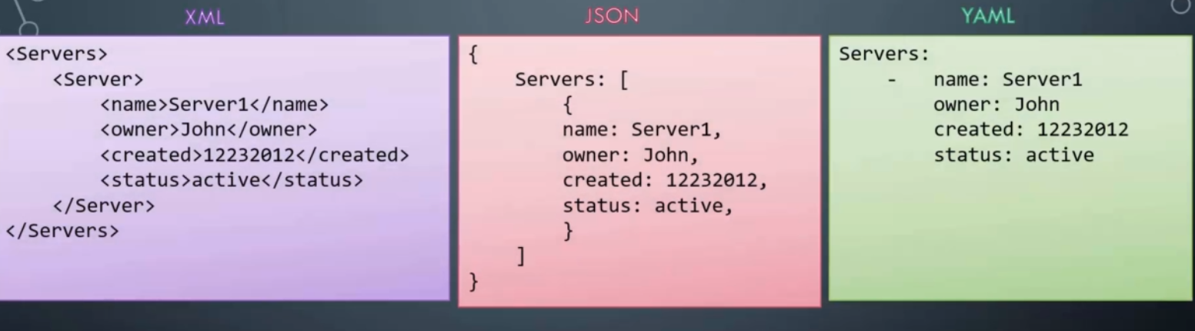

Slide 18
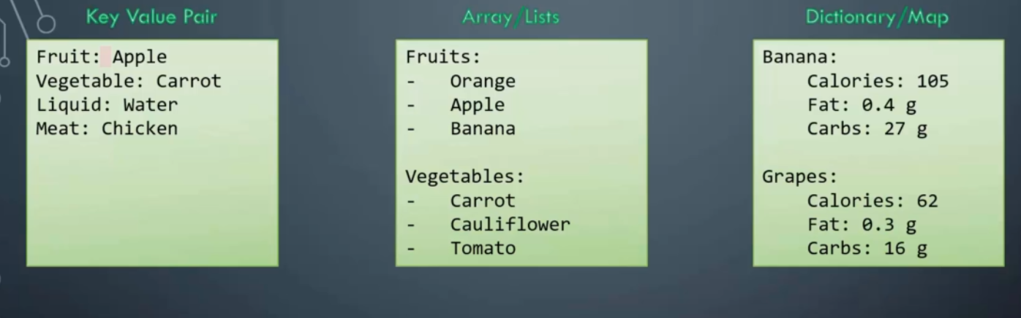
YAML

Slide 19
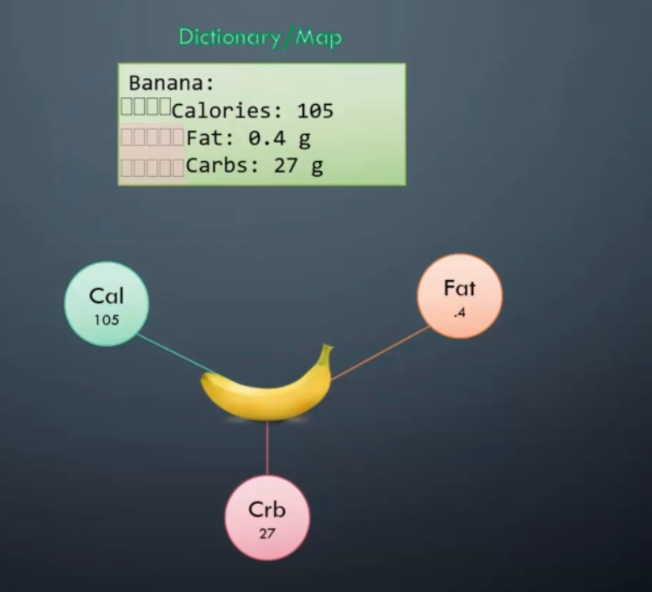
YAML (Space)

Slide 20
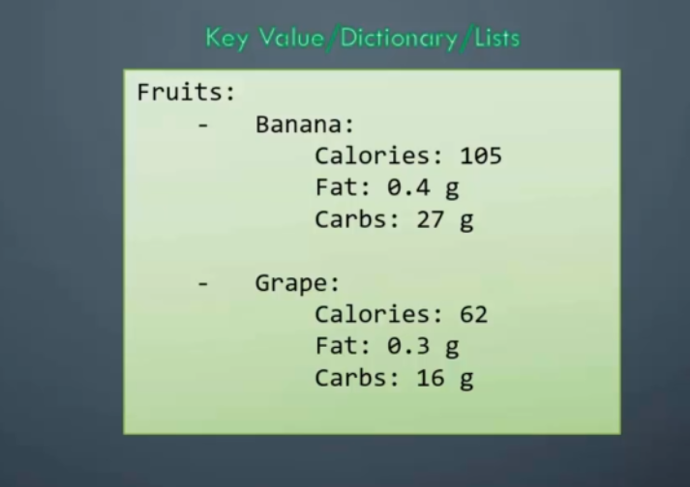
YAML (Advanced level)

Slide 21

Dictionary vs List vs List of Dictionaries
List of dictionaries

Slide 22
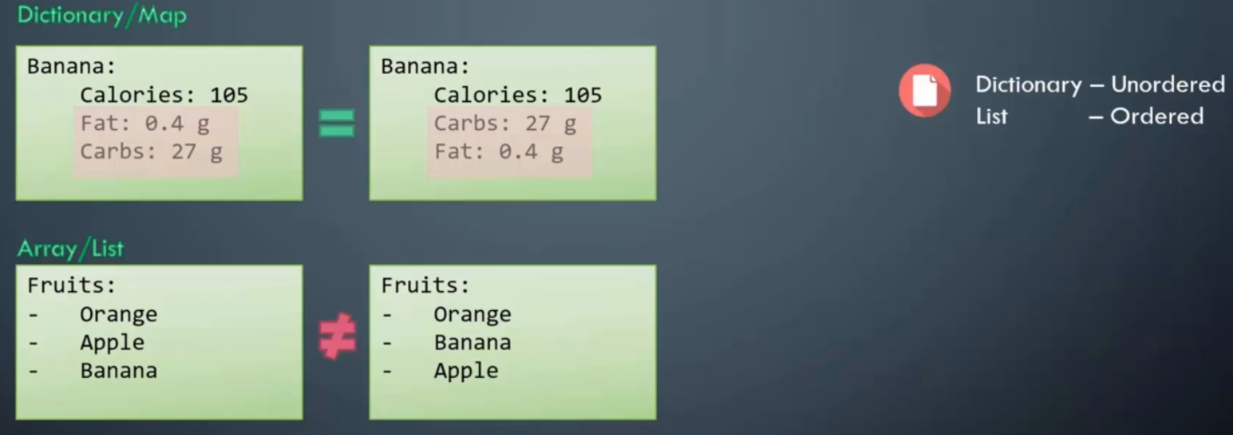
YAML (Notes)

Slide 23
EXERCICES
Create a sample YAML files

Slide 24
What is Playbook?
Playbooks are one of the core features of Ansible.
Playbook push configuration Ansible what to execute.
Its list of to-do action for Ansible.
Playbook contains a list of tasks.
Playbooks contain the steps which the user wants to execute on a particular machine.
Playbooks are run sequentially.
All playbooks written in yaml format.
Playbook define set of plays with activities to run on hosts.
A task is a single action perform on hosts.

Slide 25
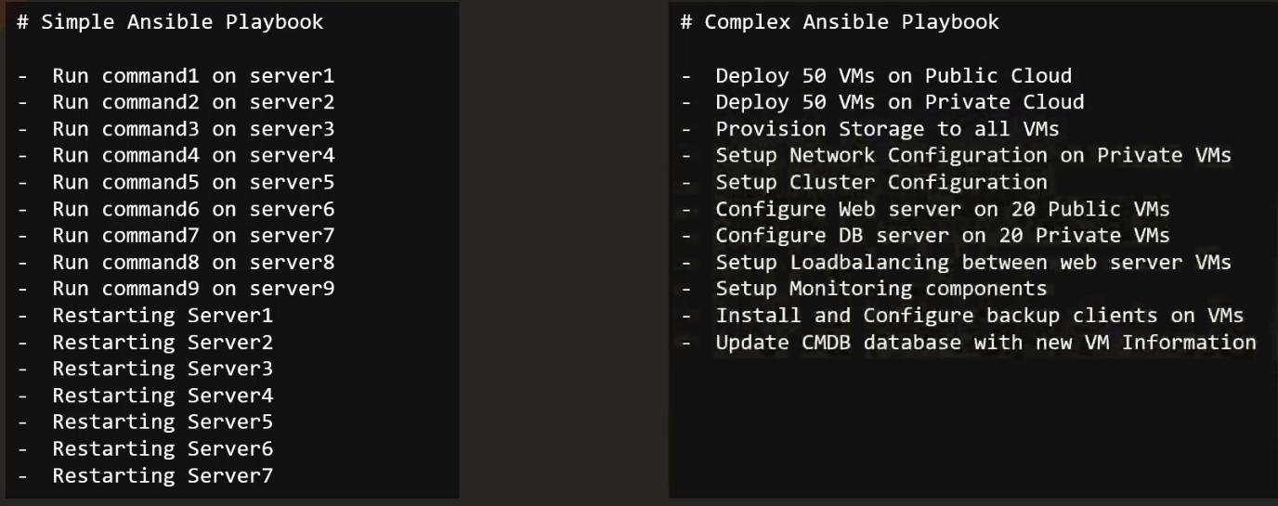
Ansible Playbooks

Slide 26
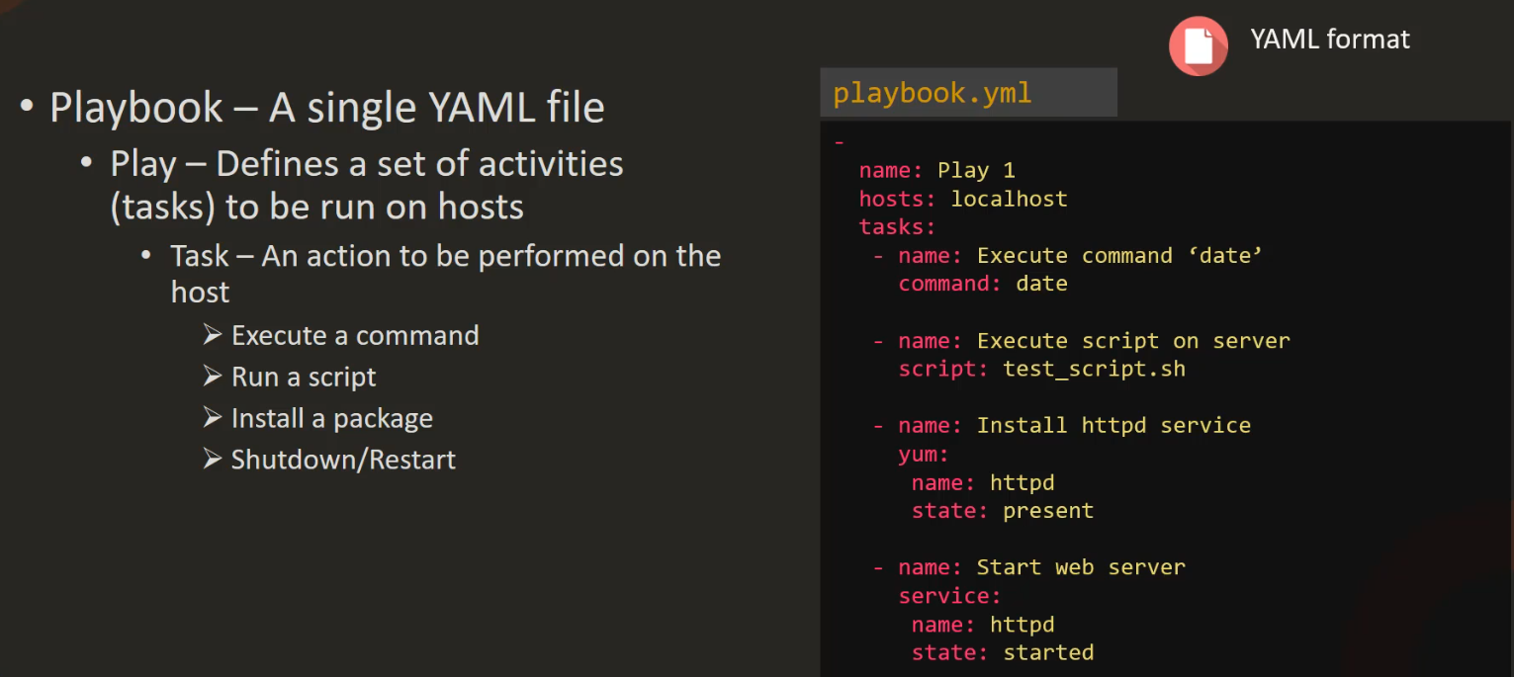
Playbook

Slide 27
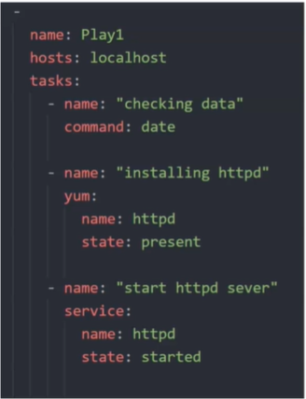
Playbook

Slide 28
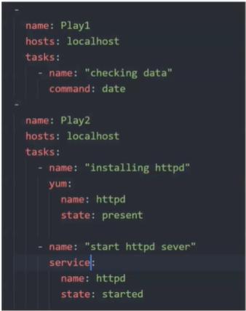
Playbook Format

Slide 29
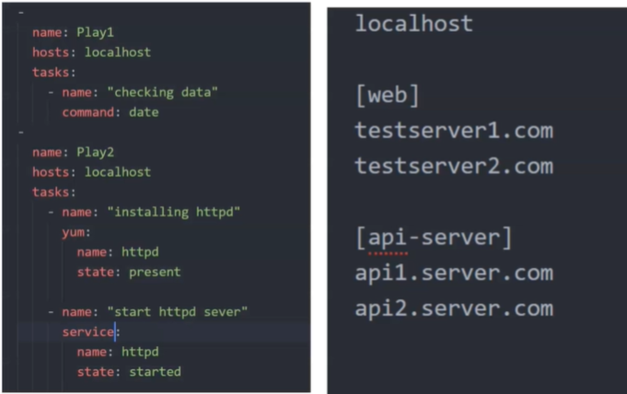
Playbook Hosts

Slide 30
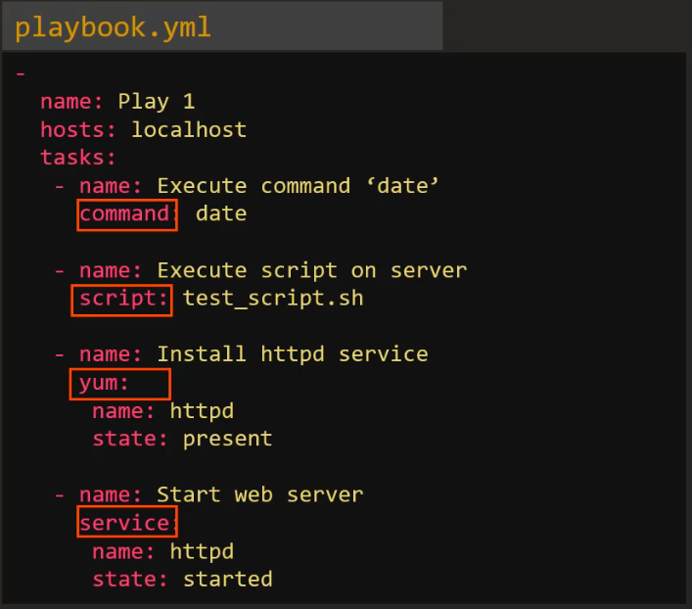
Playbook Module
$ ansible-doc -l

Slide 31
Playbook execute
Syntax: ansible-playbook <playbook name> -i <inventory file>
Example: ansible-playbook httpd.yml -i inventory.txt
Ansible
Ansible-playbook
name: play1
hosts: all
tasks:
- name: testping
ping:
Exercices:

Slide 32
How to verify playbooks in Ansible?
Check Mode: Ansible’s “dry run” where no actual changes are made on hosts.
Diff mode: allows preview of playbook changes without applying them.
use the - - check option to run a playbook in check mode.

Slide 33
ansible-lint
The importance of verifying playbooks in Ansible.
How to verify playbooks in Ansible?
check mode.
diff mode.
ansible-lint is a command line tool that performs linting on ansible playbooks, roles, and collections,
It checks your code for potential errors, bugs, stylistic errors, and suspicious constructs.

Slide 34
How to use ansible-lint?
$ ansible-lint style-example.yml

Slide 35
yaml-exemple.yml
name: play1
hosts: all
tasks:
- name: “Checking date”
command: date
- name: “installing httpd”
yum:
name: httpd
state: present
- name: “Start httpd server”
service:
name: httpd
state: started

Slide 36

Jinja2: Definition
Jinja is a web template engine for the Python programming language. It was created by Armin Ronacher and is licensed under a BSD License. Jinja is similar to the Django template engine but provides Python-like expressions while.

Slide 37

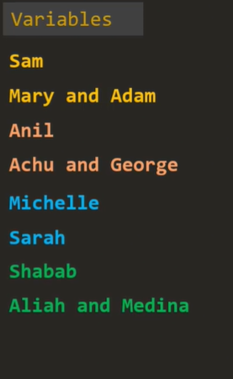
Jinja2: Templating

Slide 38


jinja2: Templating Engine

Slide 39
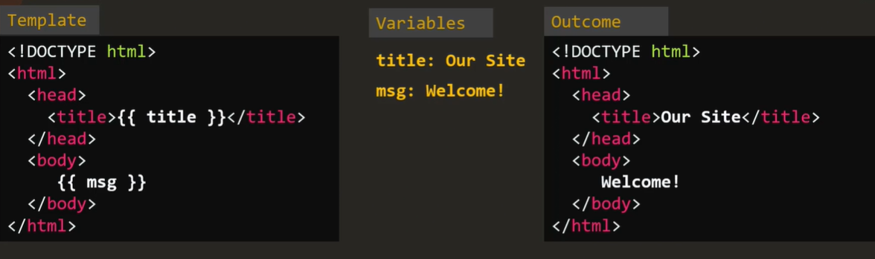
jinja2 : html (template)

Slide 40
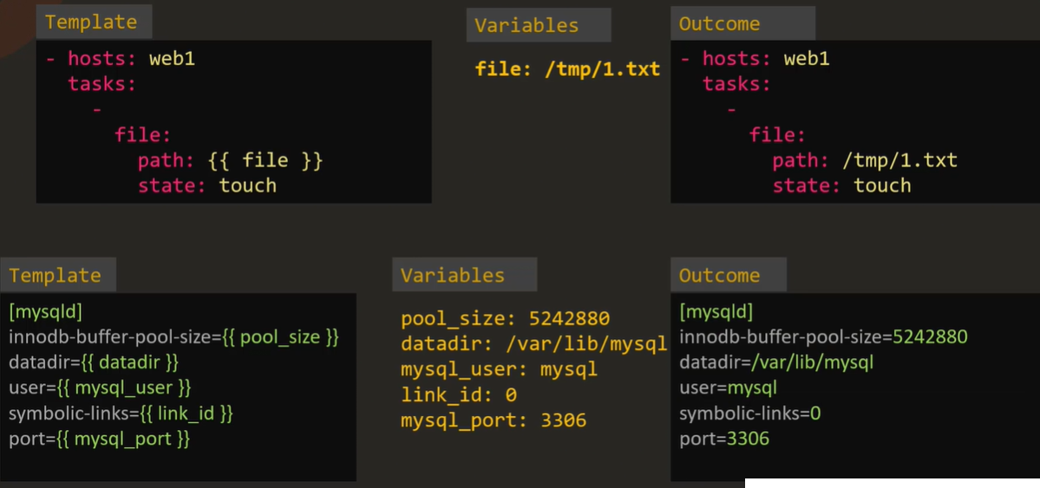
jinja2: ansible

Slide 41
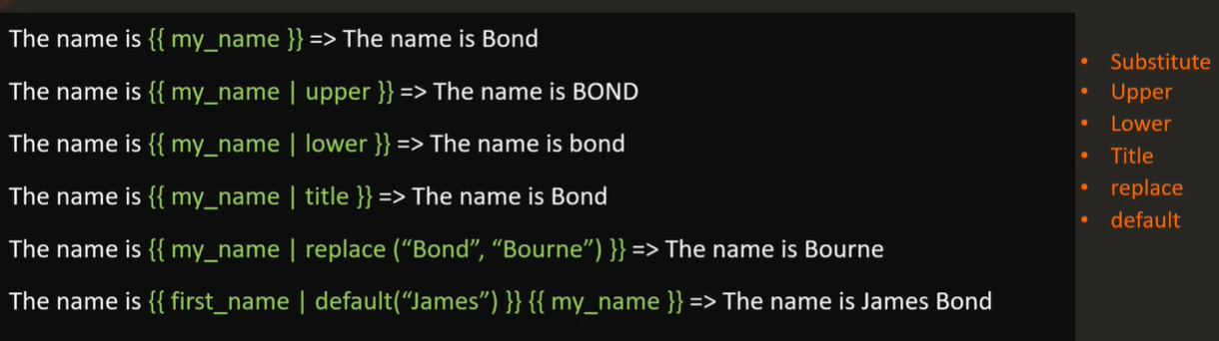
Jinja2: String Manipulation- Filters

Slide 42
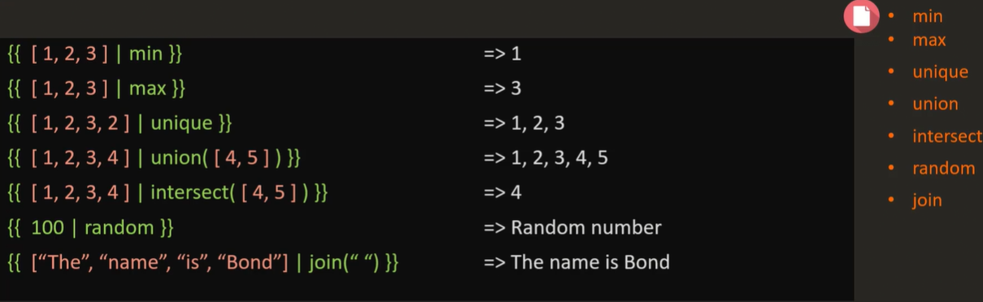
jinja2: Filters: list and set

Slide 43
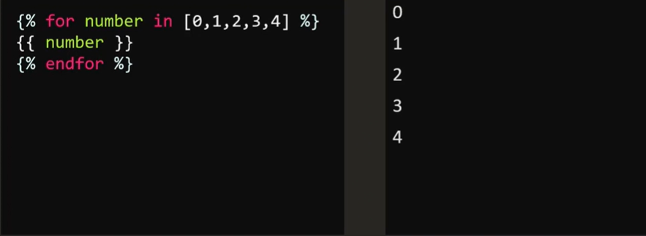
jinja2: loops

Slide 44
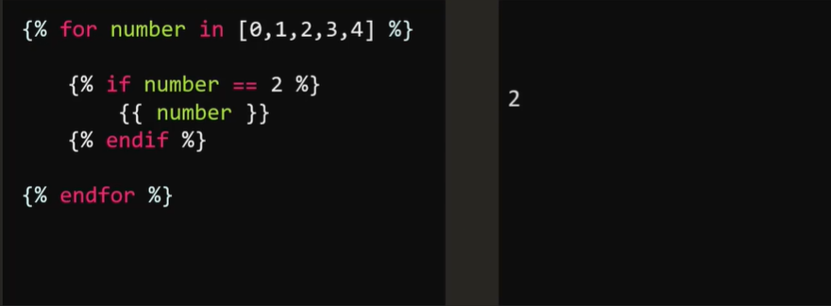
jinja2: Condition

Slide 45
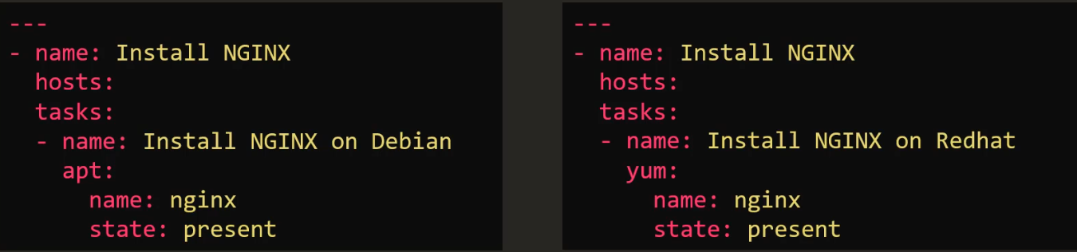
Ansible Conditionals

Slide 46
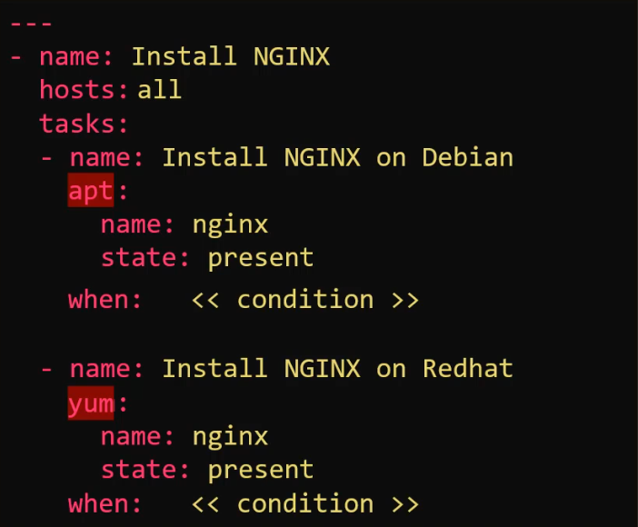
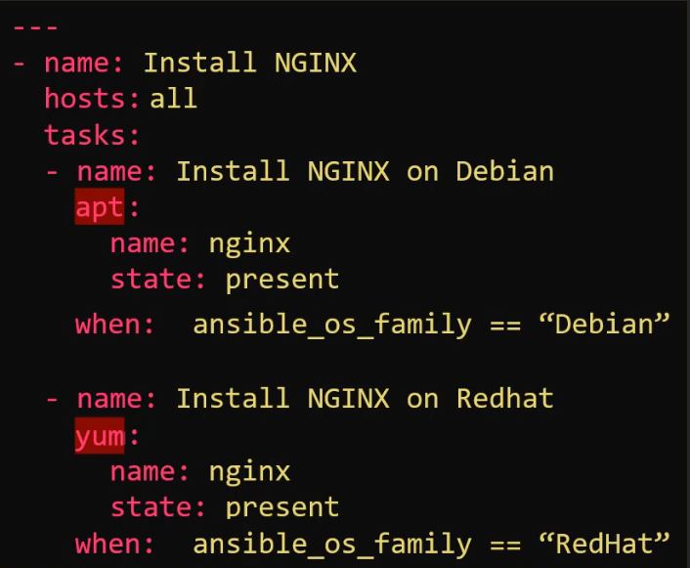
Ansible conditionals

Slide 47
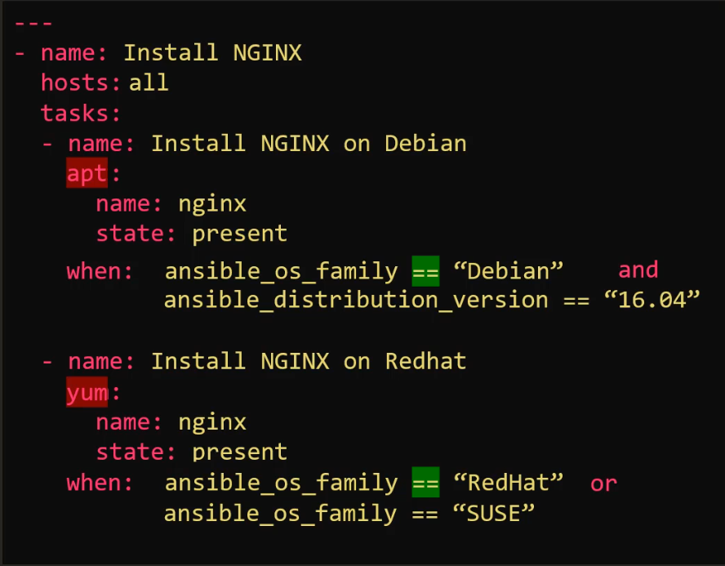
Ansible conditionals

Slide 48
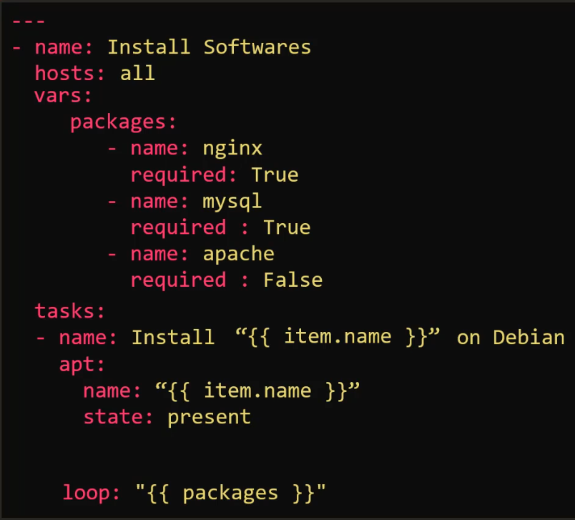
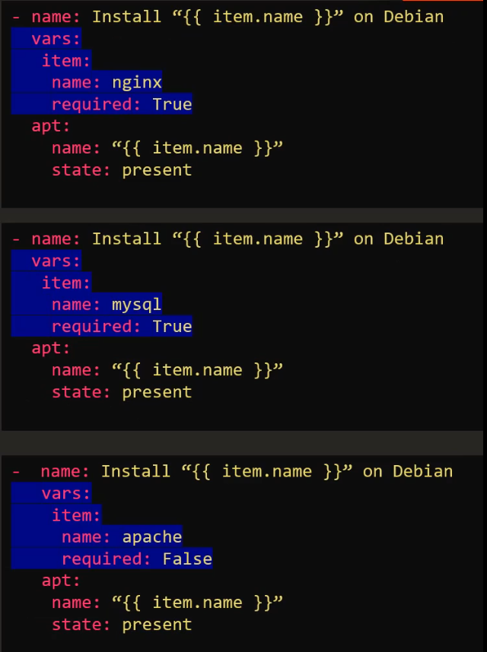
Conditionals in Loops

Slide 49
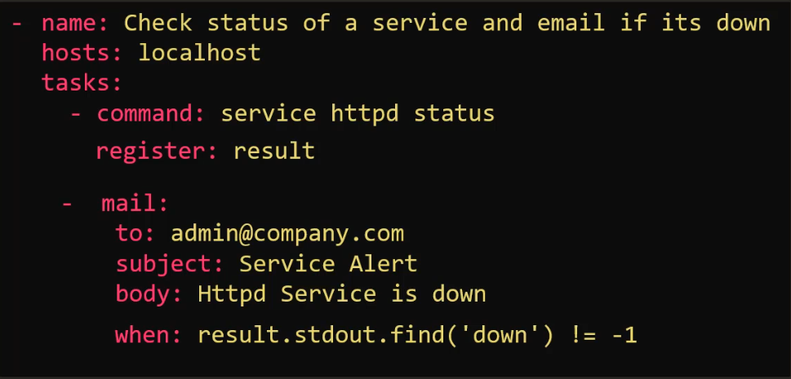
Conditionals & Register

Slide 50
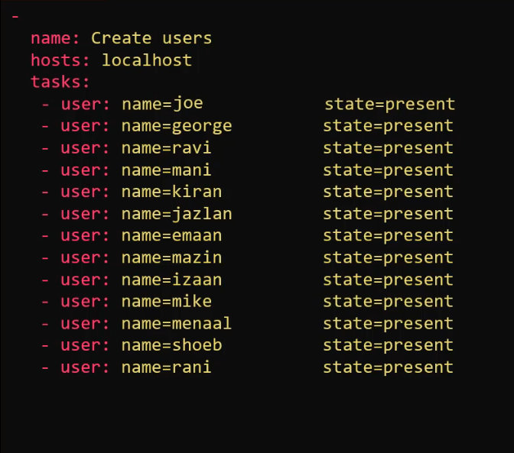
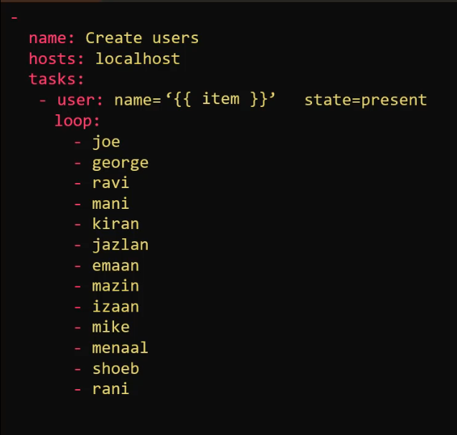
Loops:

Slide 51
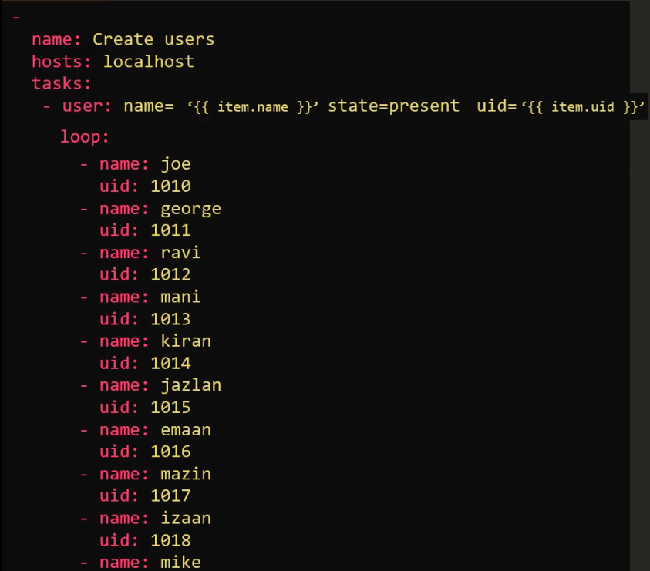
Loops:

Slide 52
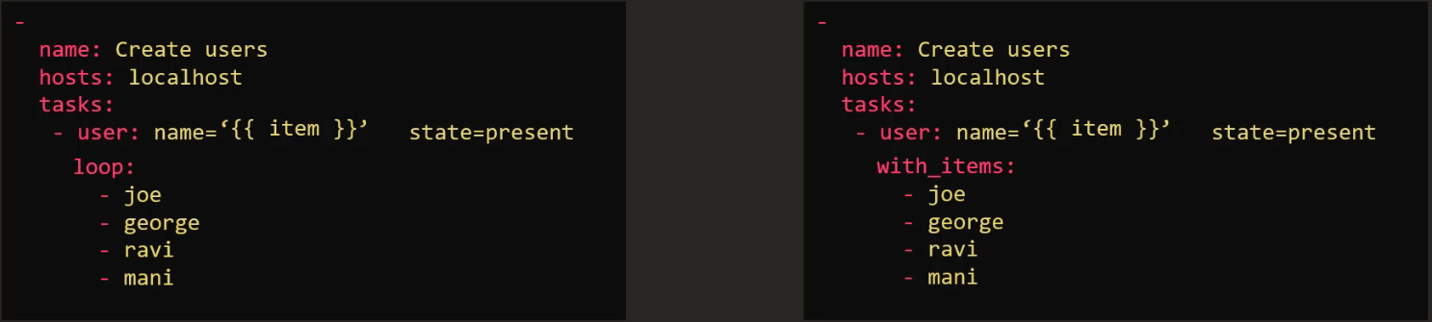
Loops: with_*:

Slide 53
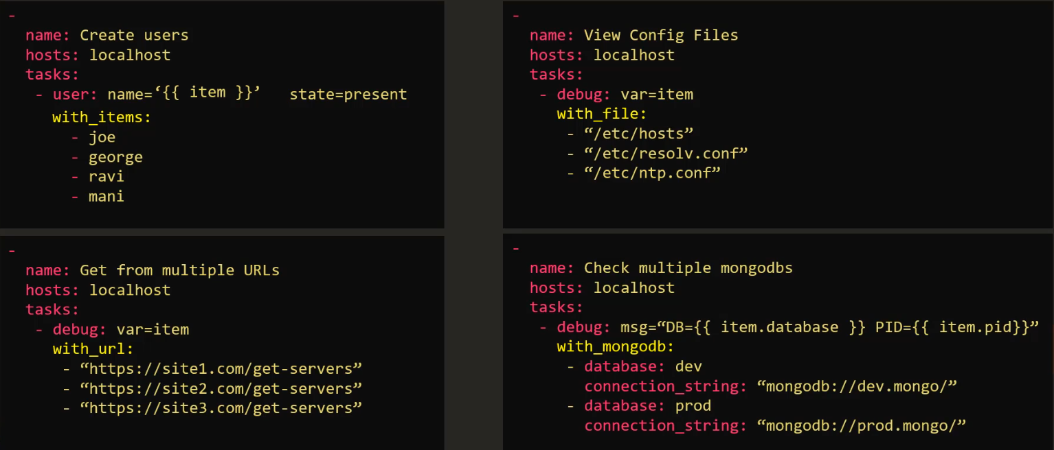
loops: with_*:

Slide 54
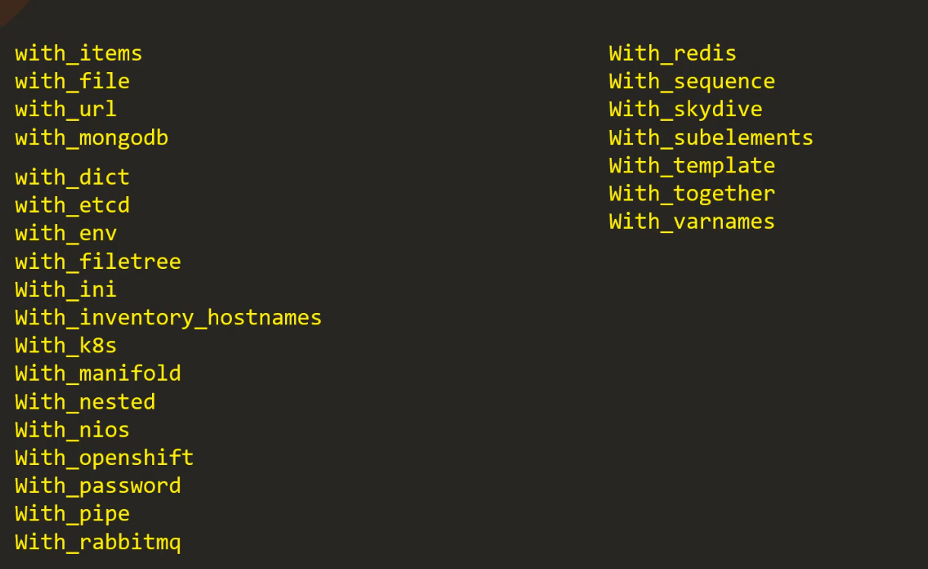
with_*

Slide 55
Ansible Modules
Ansible modules are reusable, standalone scripts that can be used by the ansible API, or by the ansible or ansible-playbook programs.

Slide 56
Ansible Modules
Cloud
Clustering
Command
File
Database
System
Windows
Monitoring

Slide 57
Ansible variables
Ansible support to declare variable for reuse
Inventory variable we used:
ansible_host
ansible_user
ansible_ssh_pass
hosts: webservers
vars:
http_port: 80

Slide 58
Ansible variables declare
Playbook with vars
Create hostname file for variable
Declare variable in inventory

Slide 59
Ansible module: system
User
Group
Hostname
Iptables
Lvg
Lvol
Make
Ping
Timezone
Systemd
Service

Slide 60
Ansible module: Commands
Command
Expect
Raw
Script
Shell

Slide 61
Ansible module: Files
Acl
Archive
Copy
File
Find
Lineinfile
Replace
Stat
Template
Unarchive

Slide 62
Ansible module: Database
Mongodb
Mssql
Mysql
Postgresql
Proxysql
vertica

Slide 63
Ansible module: Cloud
Amazon - Atomic
Azure - Centrylink
Cloudscale - Cloudstack
Digital Ocean - Docker
Google - Linode
Openstack - Rackspace
Smartos - Softlayer
Vmware

Slide 64
Ansible module: Windows
Win_copy - Win_command
Win_domain - Win_file
Win_iis_website - Wing_msg
Win_msi - Win_package
Win_ping - Win_path
Win_robocopy - Win_regedit
Win_shell - Win_service
Win_user - And more

Slide 65
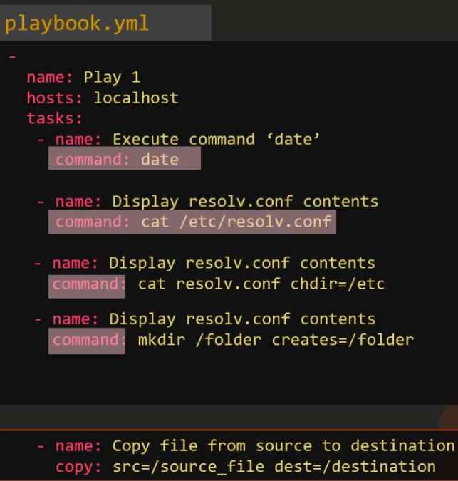
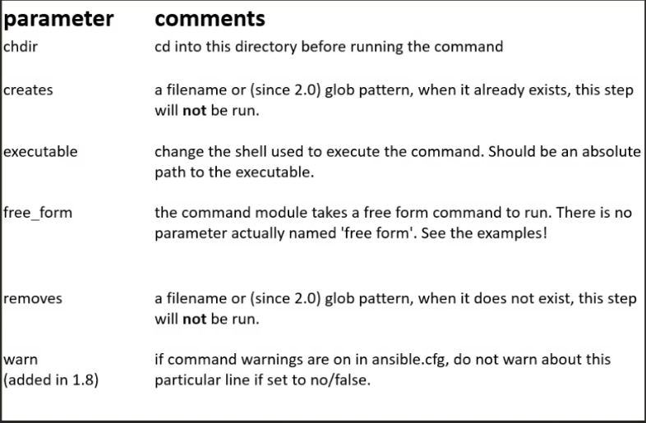
Command:
Executes a command on a remote node:

Slide 66
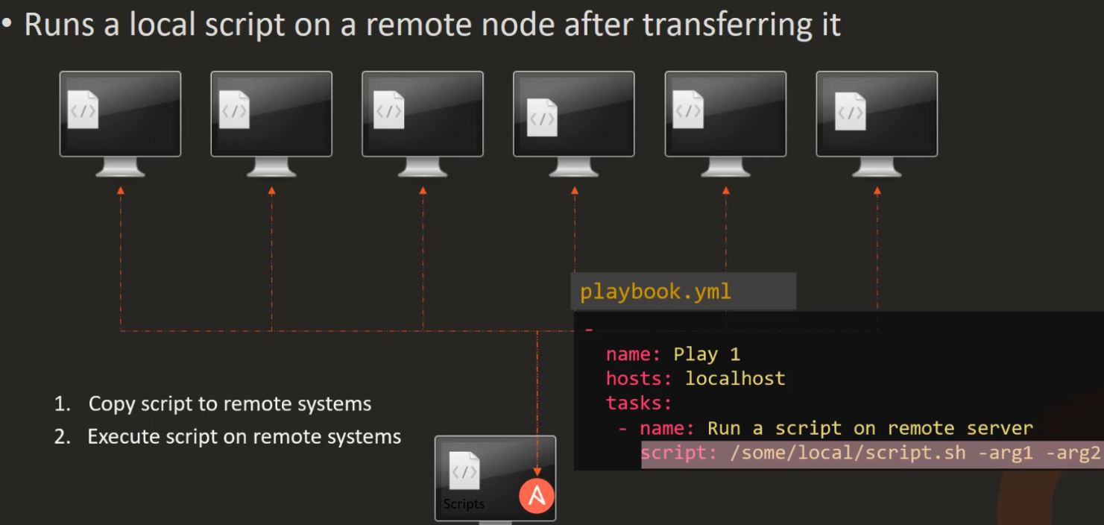
Script:

Slide 67
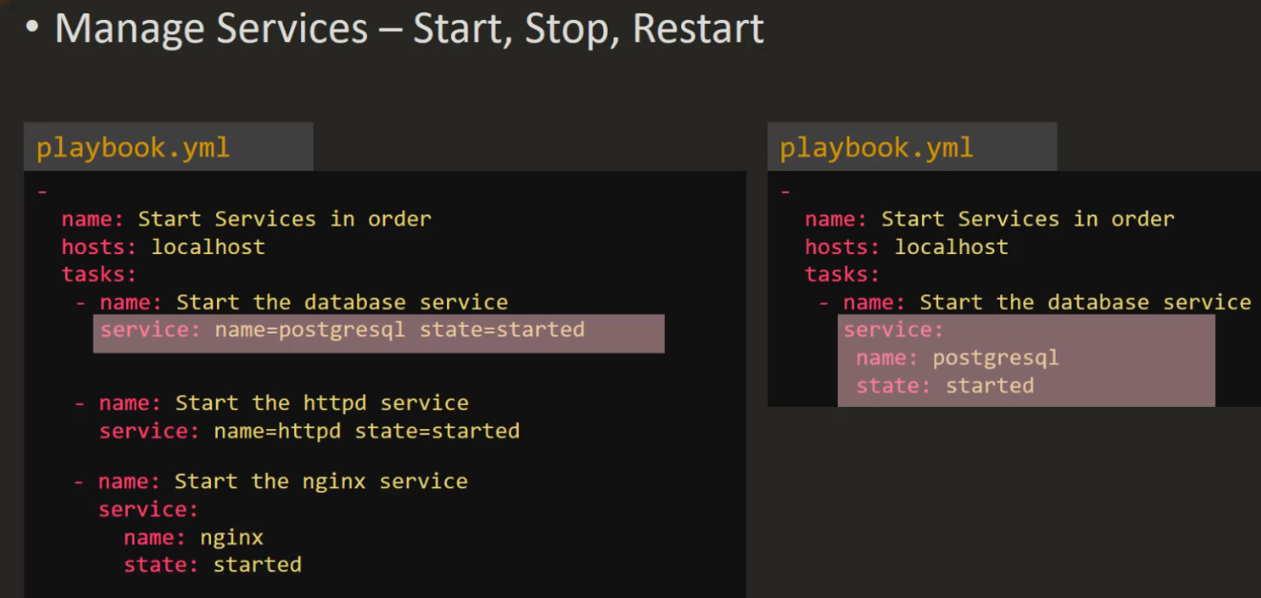
Service:

Slide 68
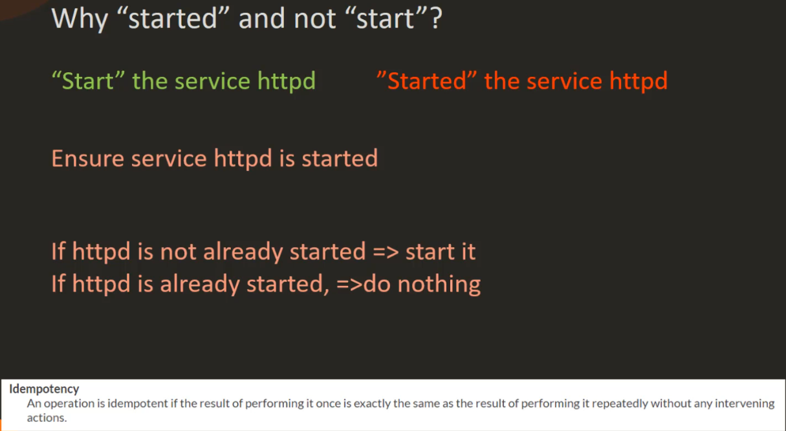
Idempotency

Slide 69
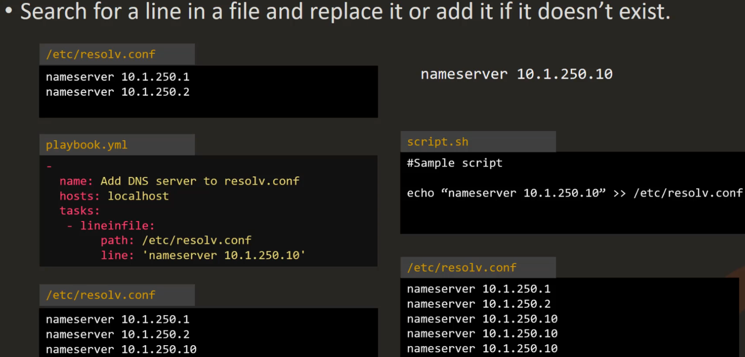
lineinfile:

